Slide 1

TICKETING APPLICATION FOR DEFECT MANAGEMENT

Slide 2

TEAM MEMBERS
Mittapalli Pavani
Pala Uma
Banu Sahthya Janga
Sukanya R
Sowjanya Pati

Slide 3
TABLE OF CONTENTS
Understanding The Problem Statement
Planning and Design
3. Coding and Execution
4. Code Testing
Challenges Faced
Conclusion

Slide 4
INTRODUCTION
A major test objective is to identify defects.
Defects are basically considered as destructive in all software development stages. Any unexpected things that occur in software stages are defective in that particular software.
To establish a defect management process is the most attractive and best way to increase and improve the quality of software. There is no such software that is present without any defect.

Slide 5
Introduction To The Problem Statement
Understanding the problem statement
Defects are assigned to programmers depending on functional area.
Information available in multiple files, are need to passed to the applications as command line arguments.
Format the defect description files.
Programmers information is available in “employees.txt”file.
Open defects from defects file for every defect find programmer who is expert in defects functional area and change status of defect.
Invalid defect entries from all input files should be stored to invalidDefect.txt file
Display error message for invalid entries and those entries should be discarded .

Slide 6
Program Flow
Input files
main.c
getdefect.c
assign.c
Output files

Slide 7
main.c
main()
Input Defect ﬁles are taken as command line arguments and also validates them.
Separate threads are created for each input ﬁles and these ﬁles are passed to getDefect() Function.
It calls getEmployee() function to fetch data from Employee Database.
Finally it waits for all threads to complete their work.

Slide 8
GetDefect ()
It reads defects from the input ﬁle
calls checkvalidity if true call validDefect() Else call invaliddefect()
It calls assignEmployee() for valid defect
.

Slide 9
assign.c
1. assignEmployee()
It loops through all defects and checks their status.
If status is open then it calls searchProgrammer() Function.
Defects with any other status are ignored.

Slide 10
2.SearchProgrammer()
Now for each defect passed, it searches for programmer in the array.
Search Criteria:
Functional Area of Defect shall match with Expertise of Programmer.
If there is a match, the defect is assigned to the programmer and createEmployeeFile() Function is called.
If no programmer could be found then uassignedDefect() Function is called for that defect.

Slide 11
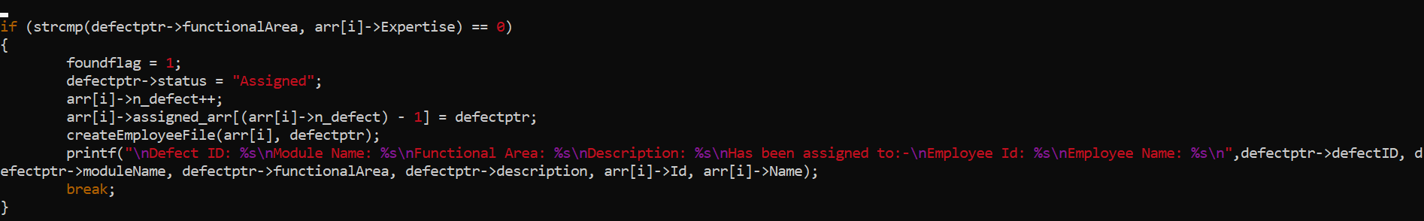
MUTEX SNAPSHOT
CODING AND EXECUTION

Slide 12
TESTING

Slide 13
FILES
defectID : description : moduleName : Functional Area: date : status : type
1. F001:Column values in BOM reports are incorrect:Aircraft design:BOM reports:21/08/2022:open:fatal
2. F002:Unit prices are not shown while preparing invoice:Invoices:Display products:23/04/2022:close:fatal
3. N001:BOM report columns not aligned properly:Aircraft design:BOM reports:21/08/2022:open:niceToHave
Defect.txt

Slide 14
EmployeeID : Name : Business Unit : Expertise : Designation
1. A123:Suresh Panchal:UK Telecom:BOM report:Principal engineer
2. D012:J K Laxmi:Finacle Systems:Display products:Junior programmer
3. C015:Sandeep Khaire:UK Telecom:Manage customers:Senior programmer
Employee.txt

Slide 15
DIFFERENT TYPES OF TEST CASES
➔ Less than or More than Actual Defect Attributes
➔ Less than or More than Actual Employee Attributes
➔ No Programmer is Found for Defect
➔ More than one Programmer is Found
➔ File is Empty or not Opening or Invalid file type
➔ Wrong Format of Defects or Employee in File
➔ Multiple Defect.txt Files
➔ Defect Status Close/Open Or Something else
➔ Defect With same Defect IDs
➔ Date Format is Wrong
➔ Space ‘ ‘ is Considered as Character EX:- : BOM report :--

Slide 16
INTEGRATIONTESTING OUTPUT

Slide 17
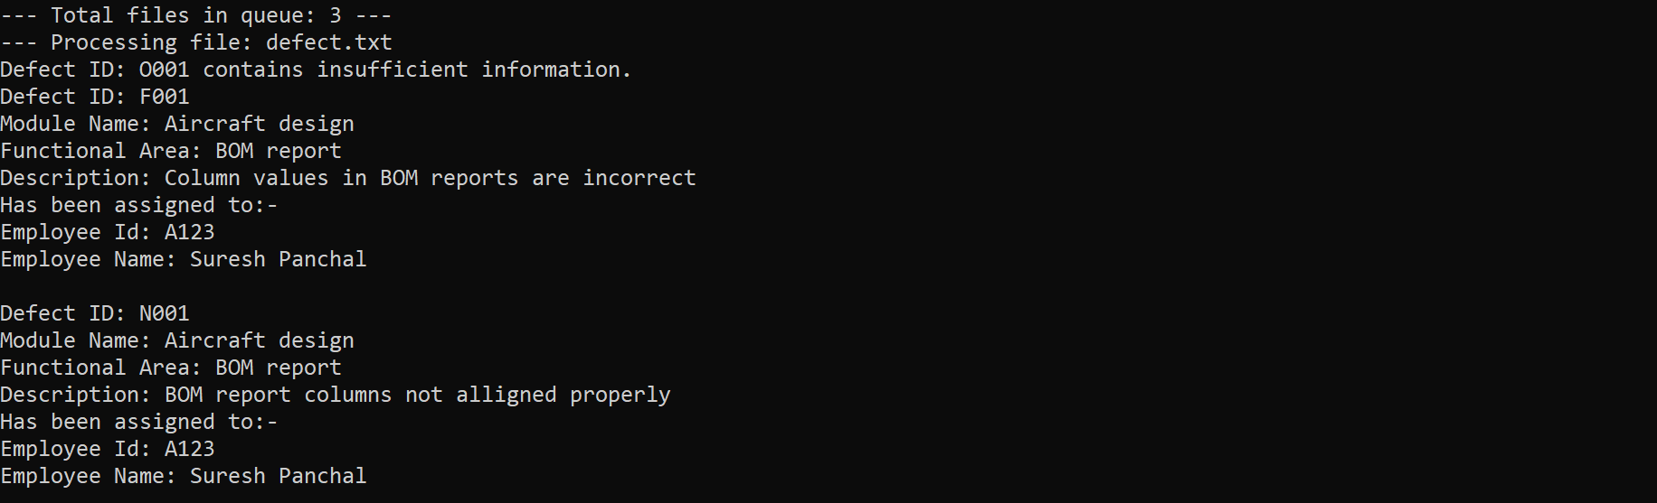
Testing output - 1

Slide 18
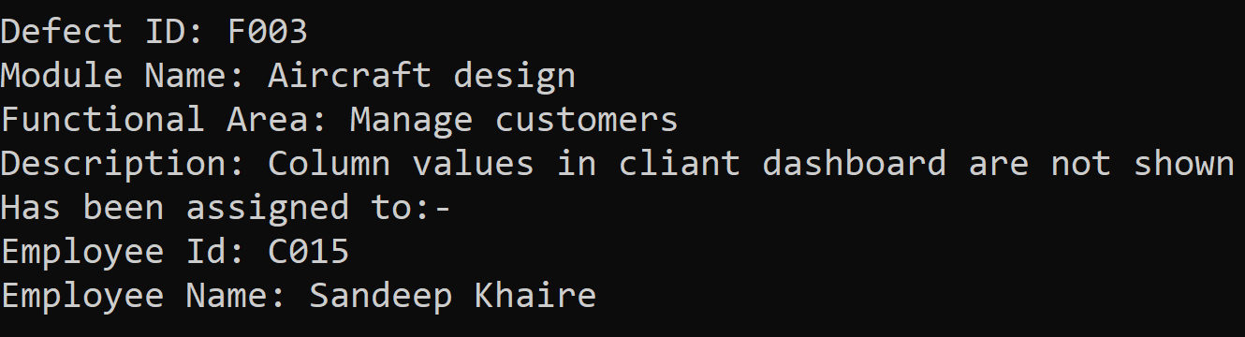
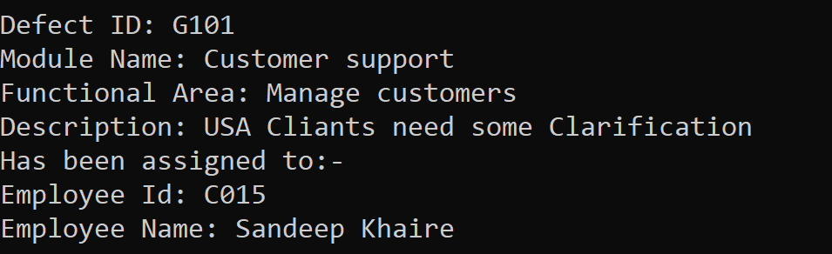
Testing output - 2

Slide 19
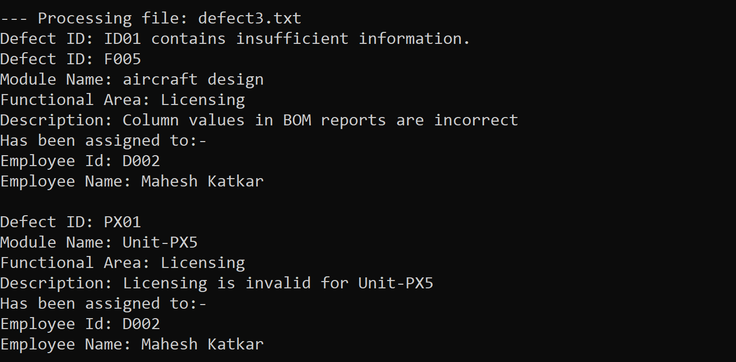
Testing output - 3

Slide 20
OVERVIEW
This project aims to develop a Defect Programmer Assignments application where clients of a Software Development company report defects in software they purchased.
These defects are assigned to programmers depending on the functional area they are handling

Slide 21
OBSTACLES
Challenges faced
To decide which data structure would be best for our project
Checking validity of the employee
Finding defect in the file from the program

Slide 22


